Slide 1

Neurophysiology
Chad Williams
University of Victoria

Slide 2
Lecture Outline
Neurons & the Membrane Potential
Action Potentials
Synapses & Communication

Slide 3
Lecture Outline
Neurons & the Membrane Potential
Action Potentials
Synapses & Communication

Slide 4
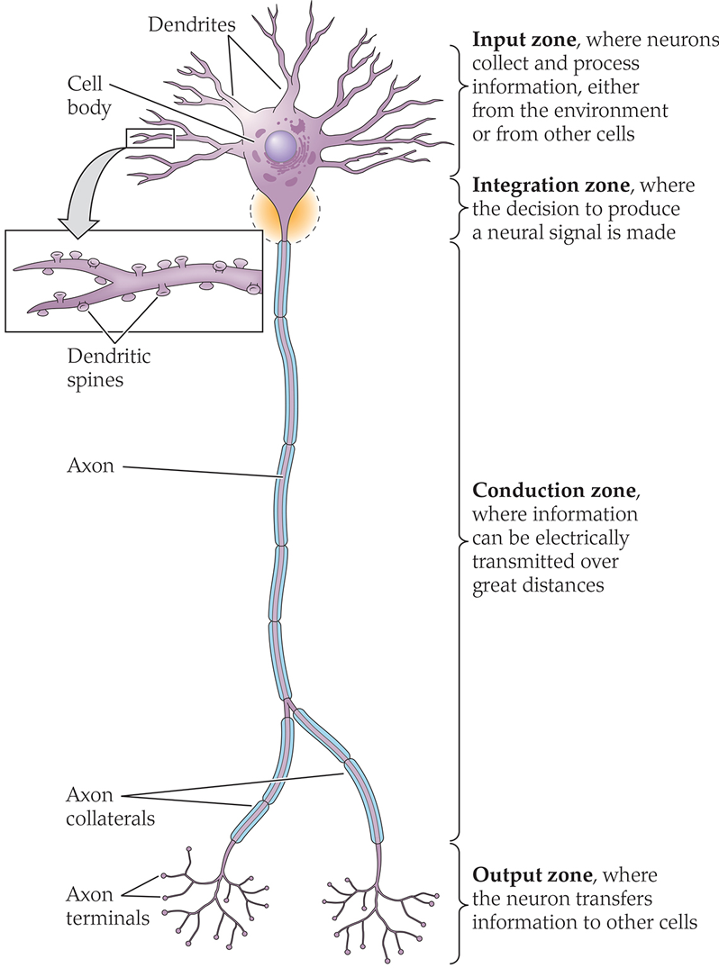
Neurophysiology
Neurophysiology: Study of electrical and chemical processes in neurons
Information flows within a neuron via electrical signals
Information passes between neurons through chemical signals

Slide 5
Neurons
Neurons: Cells of the nervous system
Dendrites (input): Cellular extensions that receive information
Integration Zone: cell body integrates information
Axons: Carry information away from the cell body
Axon terminals (output): Signals are transmitted across synapses

Slide 6
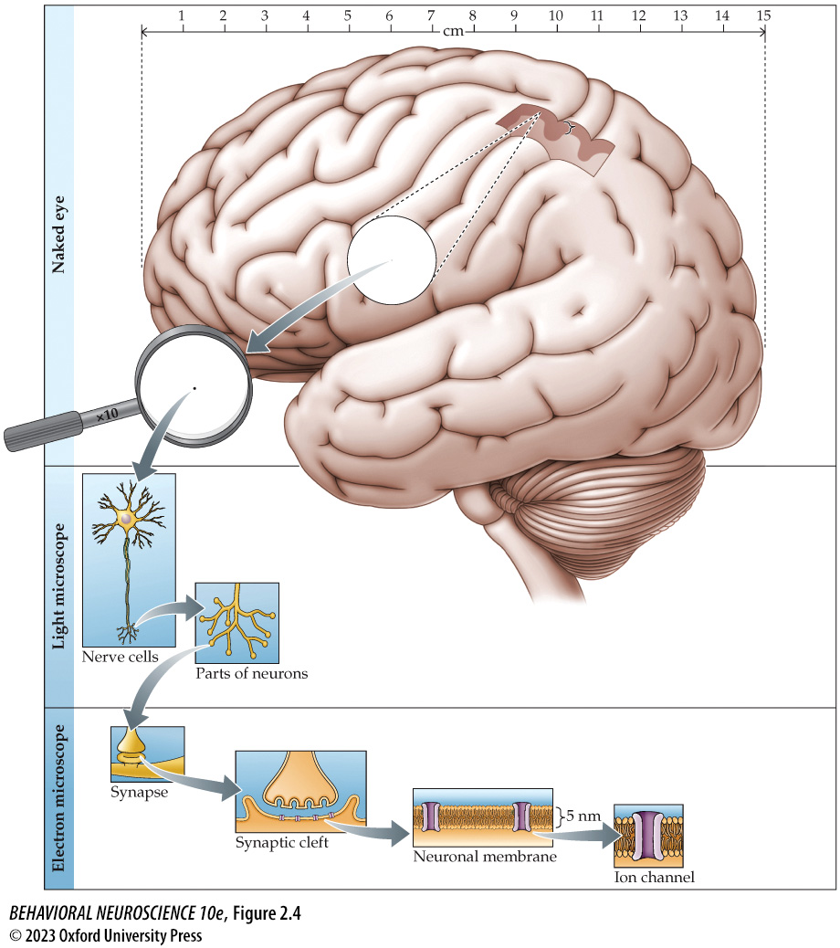
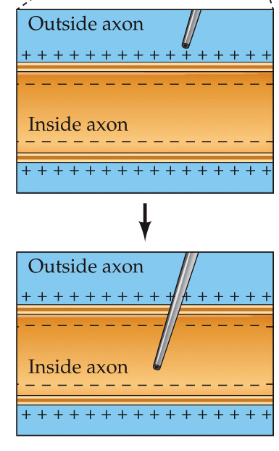
Neurons
Cell Membrane: A barrier that surrounds a cell, controlling what enters and leaves
Made up of a lipid bilayer with embedded proteins that control communication with other cells
Separates the intracellular fluid from the extracellular fluid
Proteins gate ions and molecules

Slide 7
Membrane Potential
Membrane Potential: The difference in voltage between the intracellular and extracellular fluid
Resting Potential: The potential wherein the cell is dormant
-50 to -80 mV depending on cell
Often -65 mV
Cell’s interior is negatively charged

Slide 8
Membrane Potential
Ions: Electrically charged molecules (positive or negative)
Their transportation across the membrane changes the membrane potential, which can cause neuronal firing
Ion Channels: Passive transport
e.g., potassium channel
Ion Pumps: Active transport
e.g., sodium-potassium pump

Slide 9
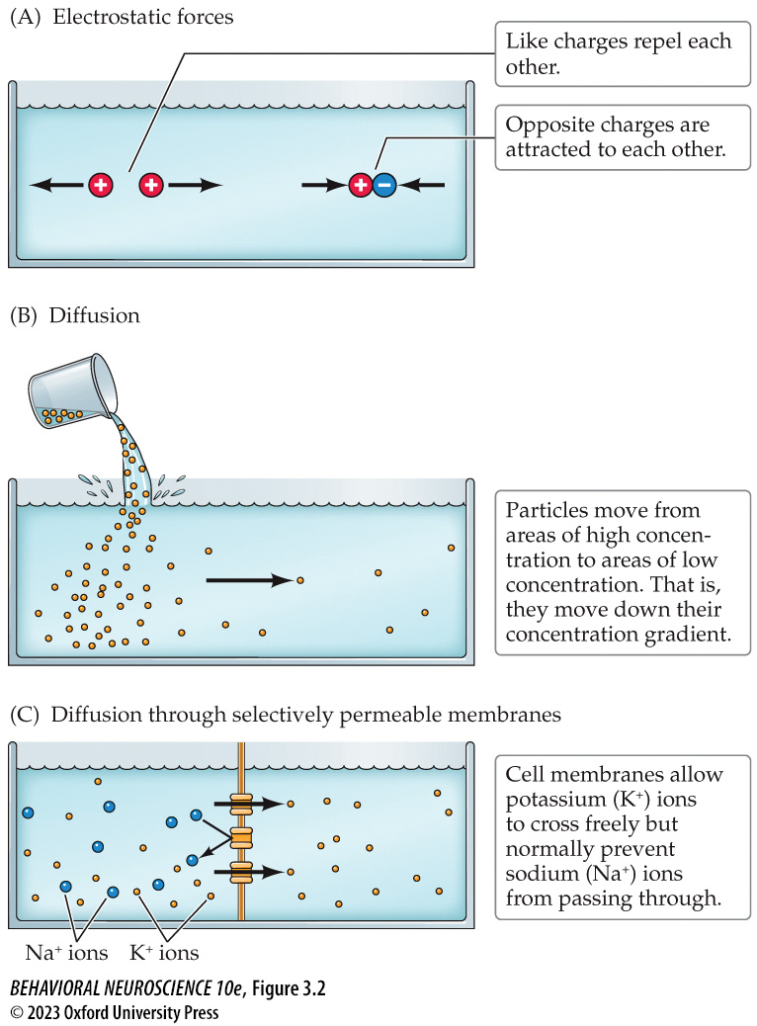
Membrane Potential
Ion Channels: Passive transport
Electrical Gradient: Ions flow towards oppositely charged areas
Concentration Gradient: Ions flow from areas of higher to lower concentration
Selectively Permeable: Channels can be specific to a charge or molecule

Slide 10
Membrane Potential
Ion Pumps: Active transport
Sodium-Potassium Pump:
Three sodium (Na+) out of cell
Two potassium (K+) into the cell

Slide 11
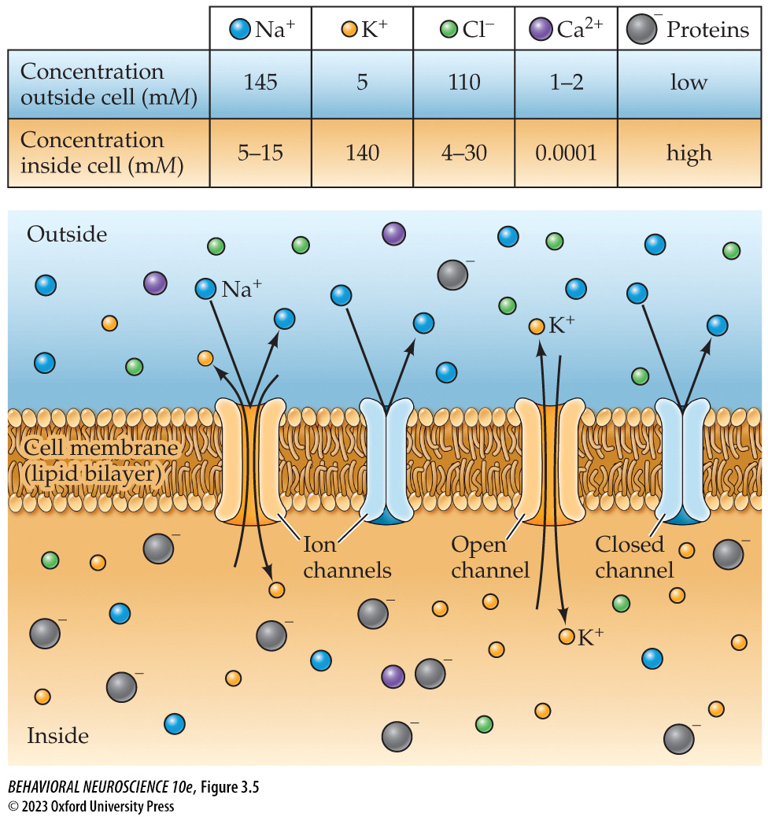
Membrane Potential
Ion Transportation at Rest:
Potassium (K+)
Moves into cell because of electrical gradient and sodium-potassium pump
Moves out of cell because of concentration gradient
Sodium (Na+)
Moves out of cell because of sodium-potassium pump

Slide 12
Membrane Potential
Ion Transportation at Rest:
Negative Proteins
Do not cross the membrane
Higher concentration within the cell
Leads to a negatively charged interior, which drives the electrical gradient

Slide 13
Lecture Outline
Neurons & the Membrane Potential
Action Potentials
Synapses & Communication

Slide 14
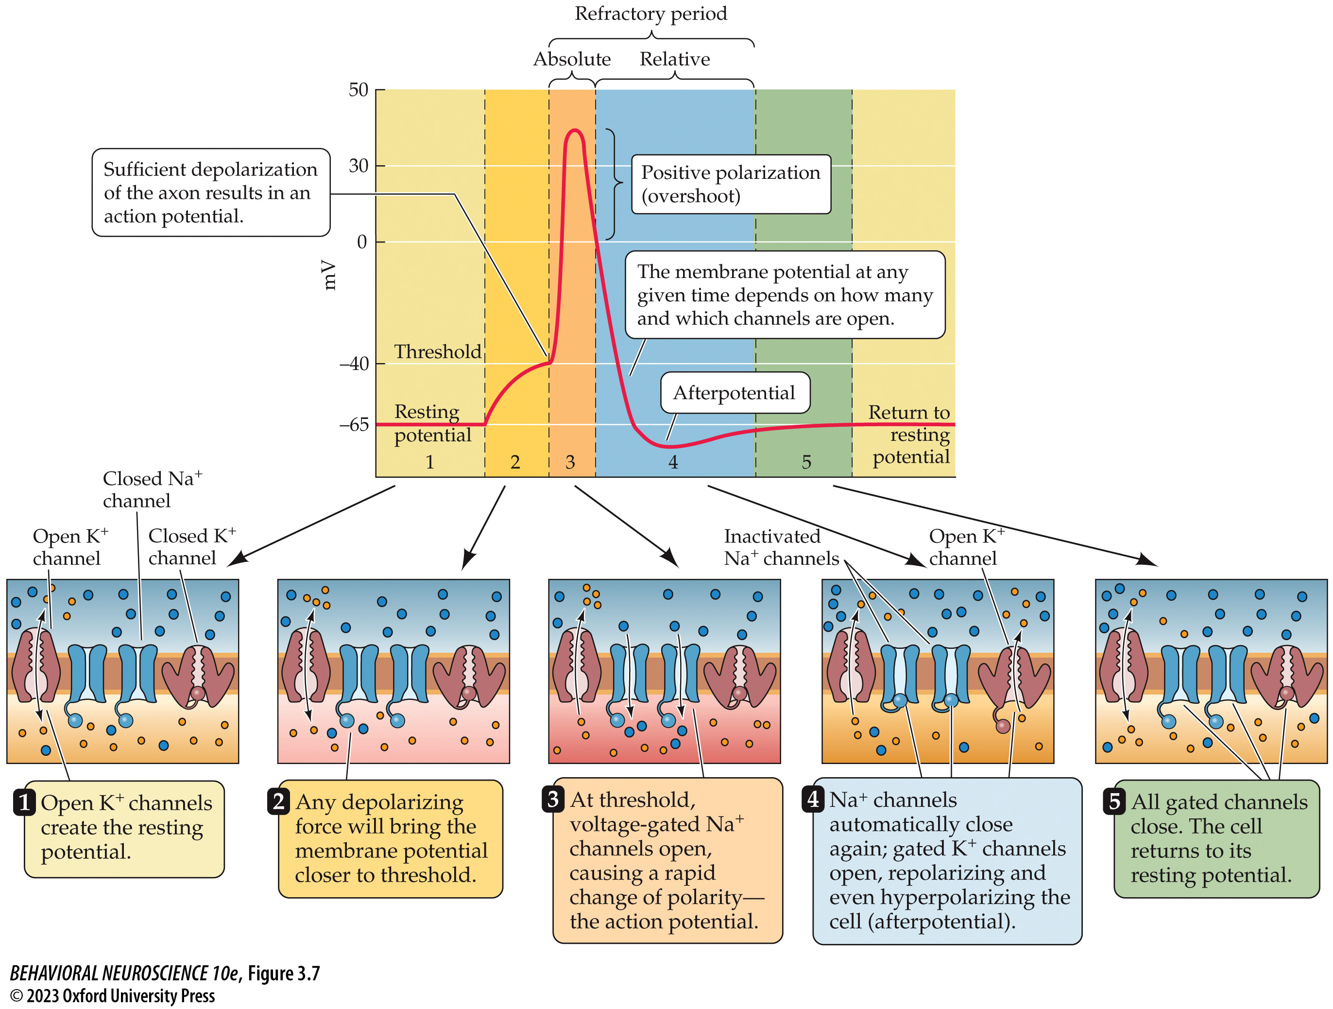
Action Potentials
Axon
hillock
Action Potential: An event that causes a change in membrane potential leading to the firing of the cell and communication with other cells
Depolarization: Molecules from other neurons change the potential of the membrane, depolarizing it until it reaches a threshold (-55 mV) at the axon hillock
Action Potential: Voltage-gated sodium channels open and sodium flows into the neuron
Repolarization: Sodium channels close, and potassium channels open so they leave the cell

Slide 15
Action Potentials
Axon
hillock
Action Potential:
Hyperpolarization: A period where the neuron is more negative due to the large loss of potassium (-80 mV), which then closes potassium channels
Resting state: Sodium-Potassium pump pushes out more sodium than it takes potassium in, resulting in the neuron to return to a passive state

Slide 16
Action Potentials
Axon
hillock

Slide 17
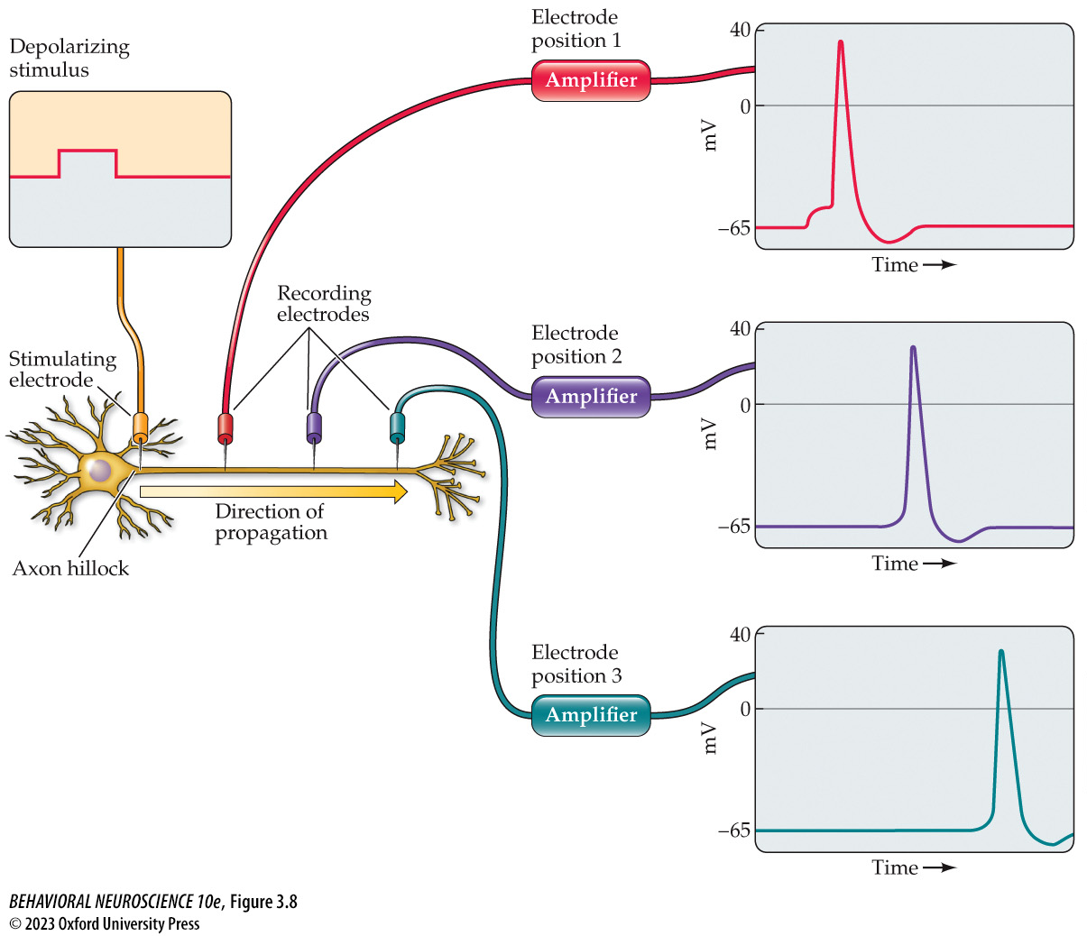
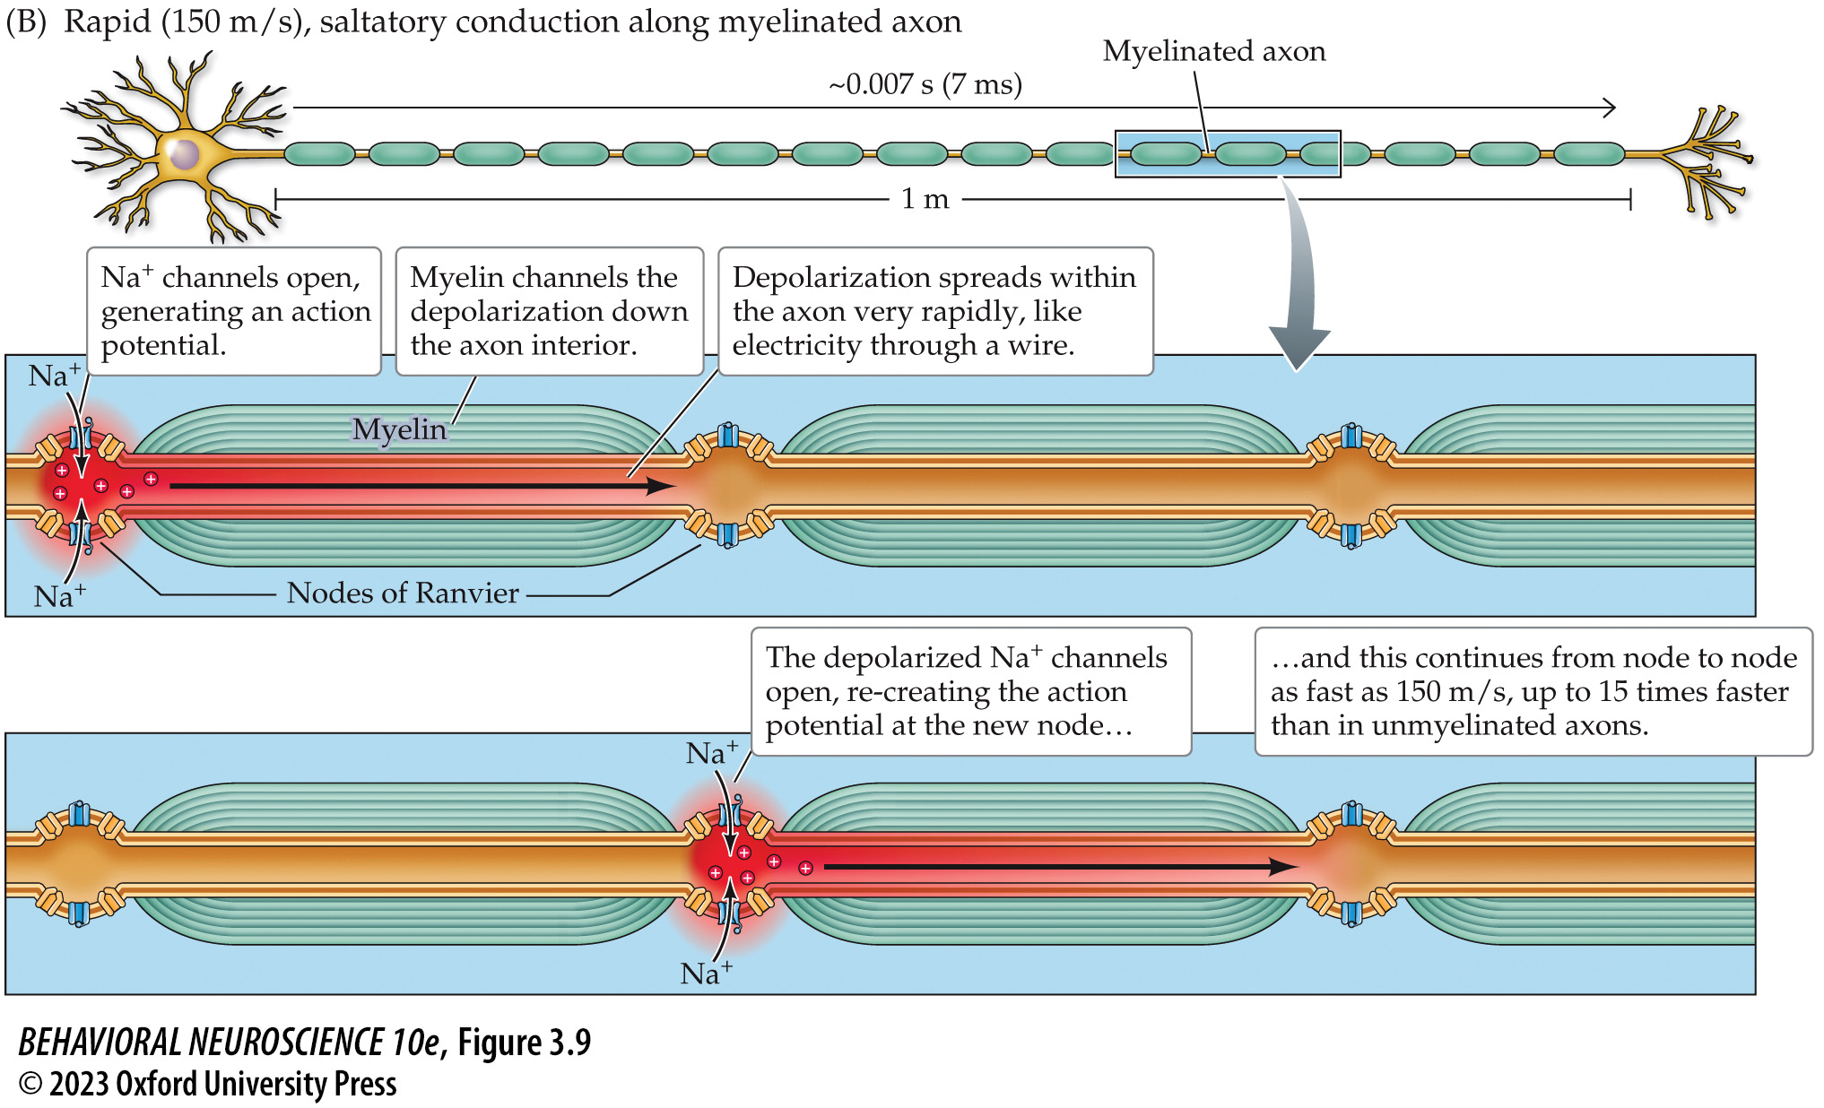
Action Potentials
Self-Regenerating
Action potentials occur at specific slices of the axon
The change of polarity at one slice will cause the same change at the next slice
The hyperpolarization of the last slice stops the action potential from going back towards cell body
Sped up by jumping to nodes of ranvier, between myelin

Slide 18
Lecture Outline
Neurons & the Membrane Potential
Action Potentials
Synapses & Communication

Slide 19
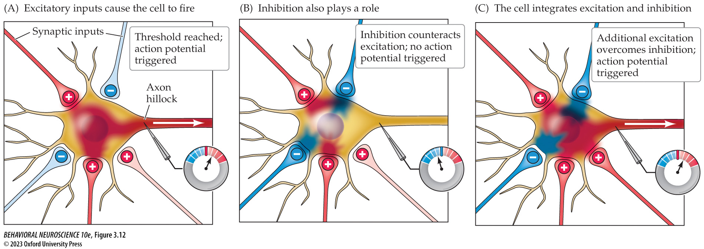
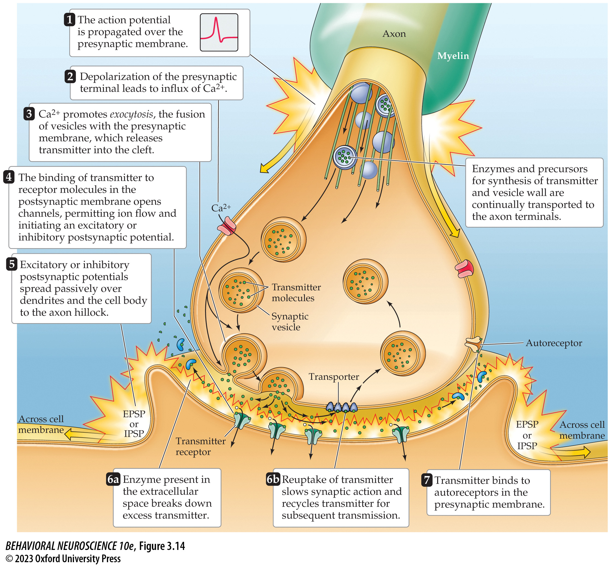
Synapses and Communication
Neurotransmitter release:
The action potential ends in the axon terminal, which triggers communication with other neurons
Action potentials result in calcium (Ca²⁺) entering the terminal
Causes vesicles to fuse with membrane
Exocytosis: Vesicle fusing which releases transmitters in the synaptic cleft
More on transmitters in next unit

Slide 20
Synapses and Communication

Slide 21
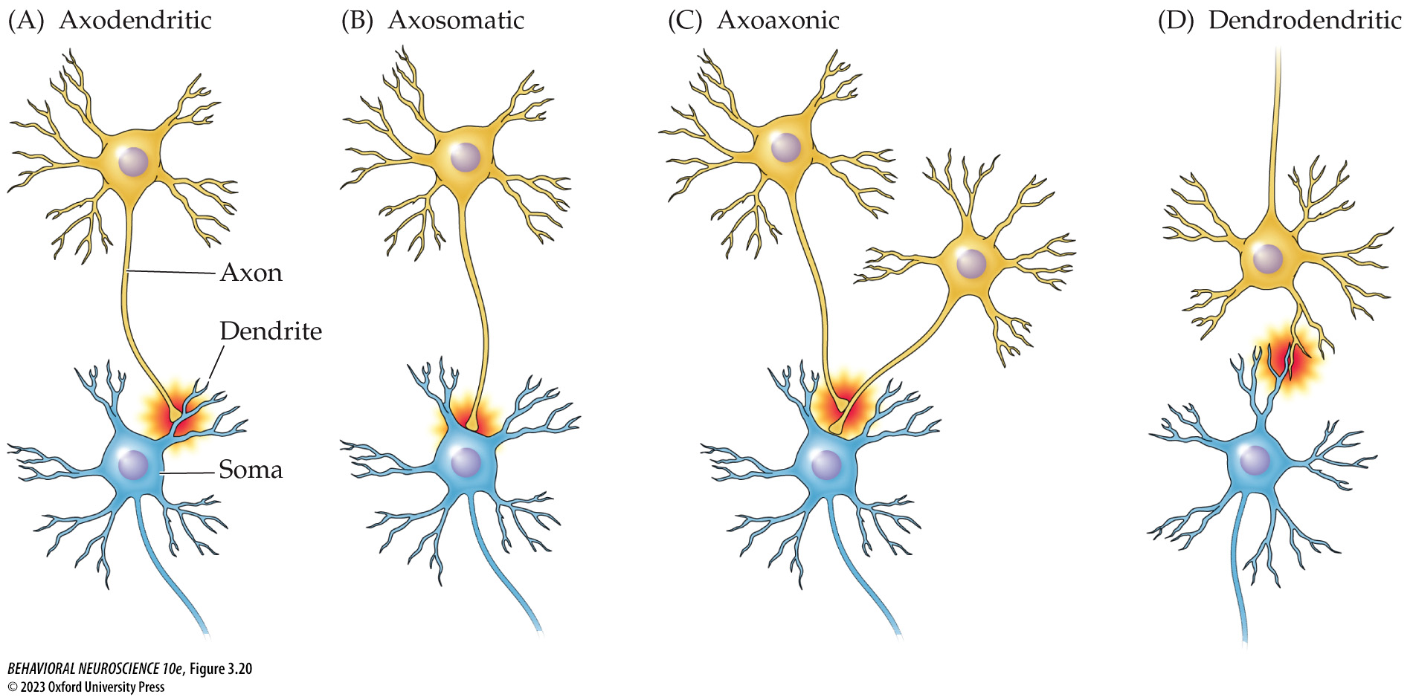
Synapses and Communication
Types of Synapses

Slide 22
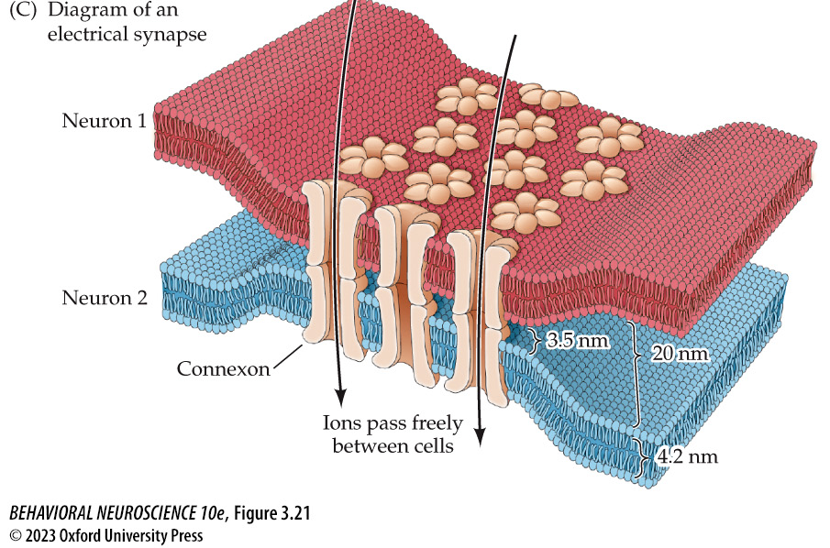
Synapses and Communication
Types of Communication
Neurotransmitter Communication: Action potential releases neurotransmitter which binds to channels on next neuron
Ionic Communication: Action potential moves ions directly into next neuron via connexon
Does not require moving through the cleft
Faster than converting to NT

Slide 23
Synapses and Communication
Postsynaptic potential (PSP): Brief changes in membrane potential
These are localized and temporary
They move outward (like a drop in water)
Inhibitory: Reducing the likelihood of an action potential
Hyperpolarizing
Causes Inhibitory PSP (IPSP)
Excitatory: Increasing the likelihood of an action potential
Depolarizing
Causes Excitatory PSP (EPSP)

Slide 24
Synapses and Communication
Postsynaptic potential (PSP)
Spatial summation: Potentials summate if close together in space
The distance of the synaptic input from the axon hillock also determines the strength of the communication
Temporal summation: Potentials summate if close together in time
PSPs fade over time, so timing is important
If there are sufficiently more EPSPs than IPSPs at the axon hillock, an action potential will fire

Slide 25
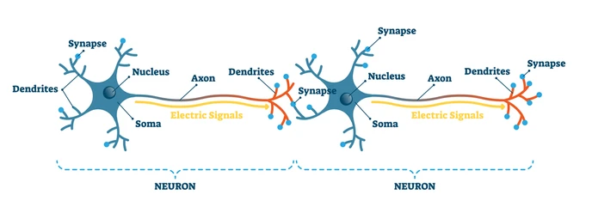
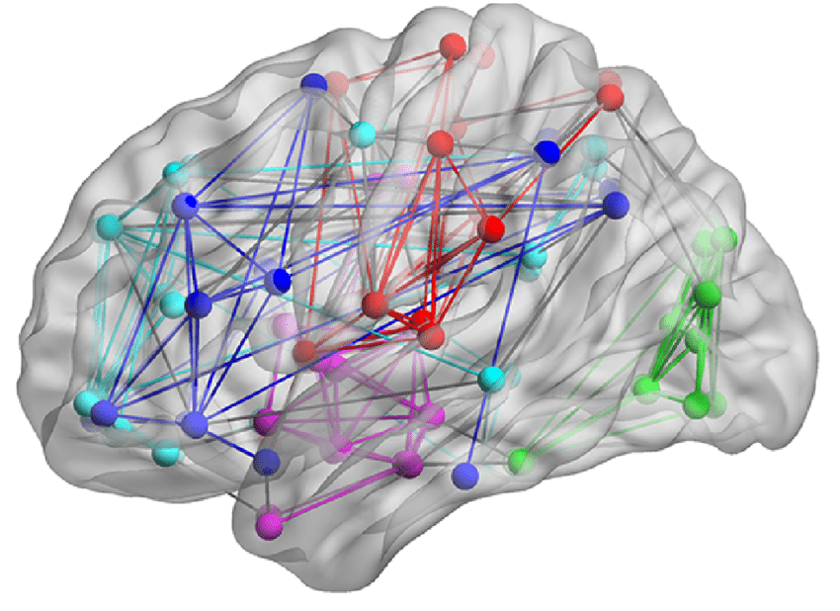
Neural Networks
Neurons are chained together
Chains of neurons form neural networks that can span the brain and body

Slide 26

Testable Figures
Slide 21
All figures corresponding to the results of a study are testable material.

